Slide 1

City of Fontana
Redistricting 2021-2022
Douglas Johnson
National Demographics Corporation

Slide 2
Redistricting Process Recap
Step | Description
Two Initial Hearings October 12 & October 26 | Held prior to release of draft maps. Education and to solicit input on the communities in the Districts.
Census Data Release Mid/Late August | Census Bureau releases official 2020 Census population data.
California Data Release Early October 2021 | California Statewide Database releases California’s official ‘prisoner-adjusted’ 2020 redistricting data.
Two Draft Map Hearings January 25 & March 8 | Two Public Hearings to discuss and revise the draft maps and to discuss the election sequence.
Map Selection March 22 | Public hearing followed by Council selection of a map.
Final Adoption April 12 | Council formal adoption of selected map by resolution.
Map Adoption By April 17, 2022 | Final map must be posted at least 7 days prior to adoption. Map adopted via ordinance.*

Slide 3
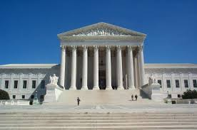
Redistricting Rules and Goals
1. Federal Laws
2. California Criteria for
Cities (rank ordered)
3. Other Traditional Redistricting Principles
Equal Population
Federal Voting Rights Act
No Racial Gerrymandering
Geographically contiguous
Undivided neighborhoods and “communities of interest”
(Socio-economic geographic areas that should be kept together)
Easily identifiable boundaries
Compact
(Do not bypass one group of people to get to a more distant group of people)
Prohibited:
“Shall not favor or discriminate against a political party.”
Minimize voters shifted to different election years
Respect voters’ choices / continuity in office
Future population growth
Preserving the core of existing districts

Slide 4
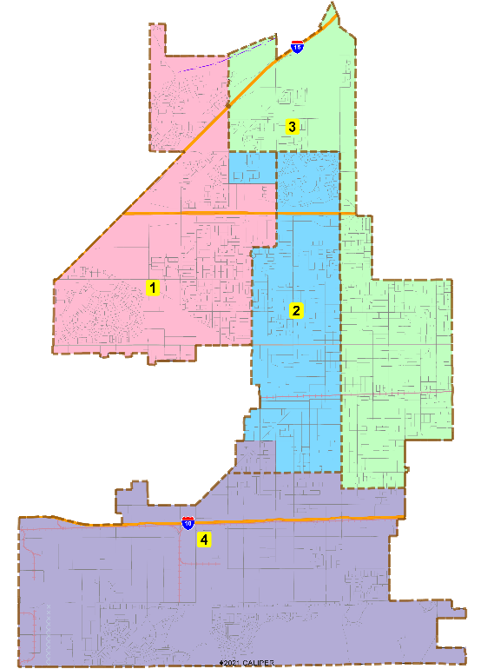
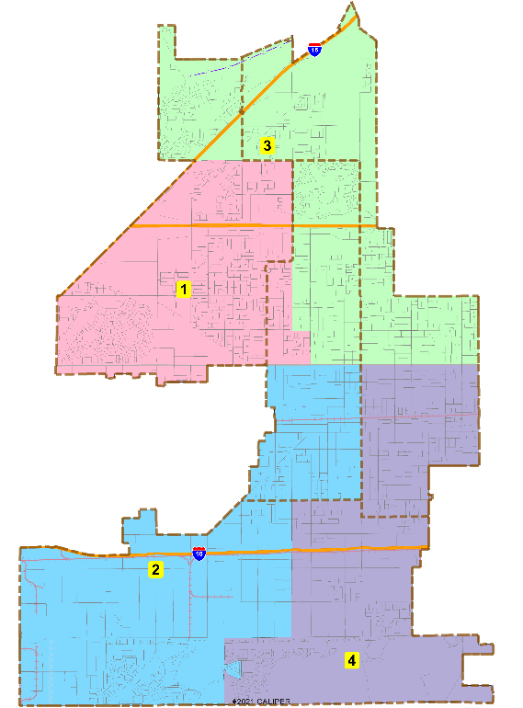
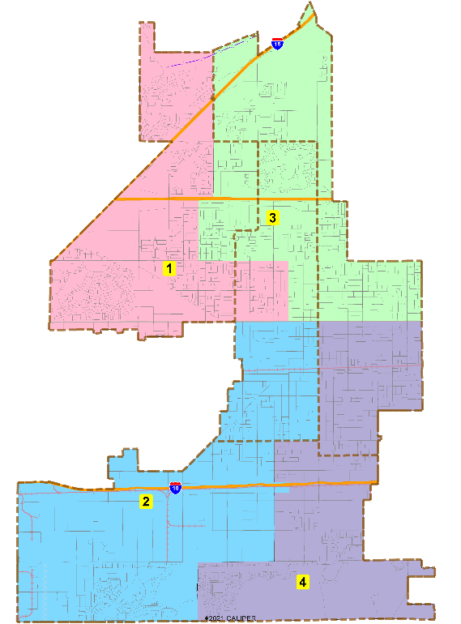
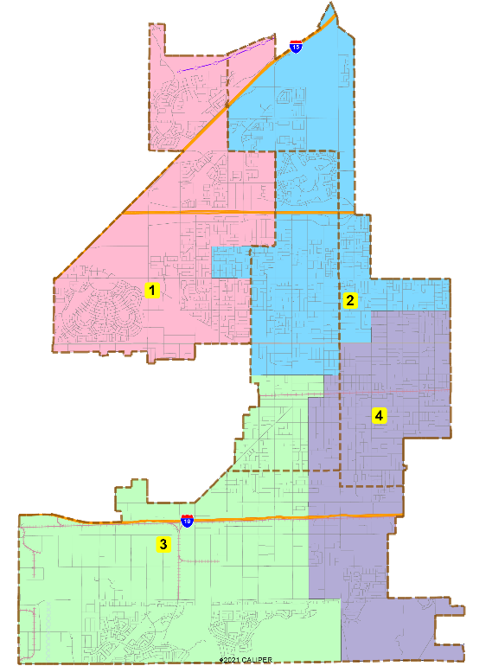
Initial Draft Maps
101
102
103
104
Interactive Review Map

Slide 5
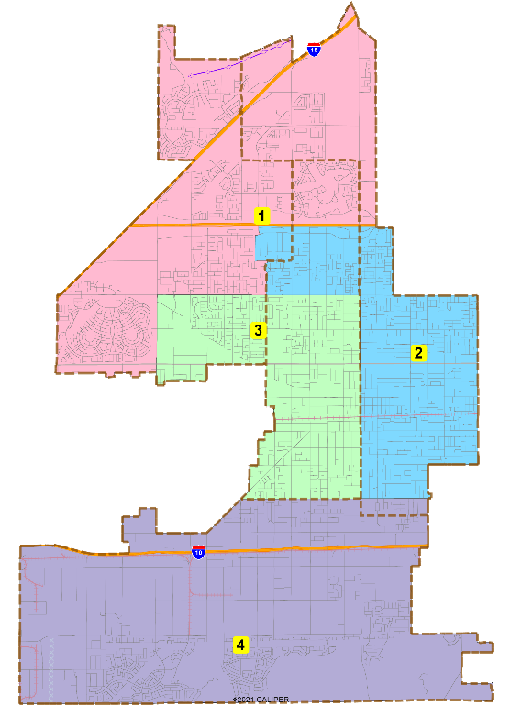
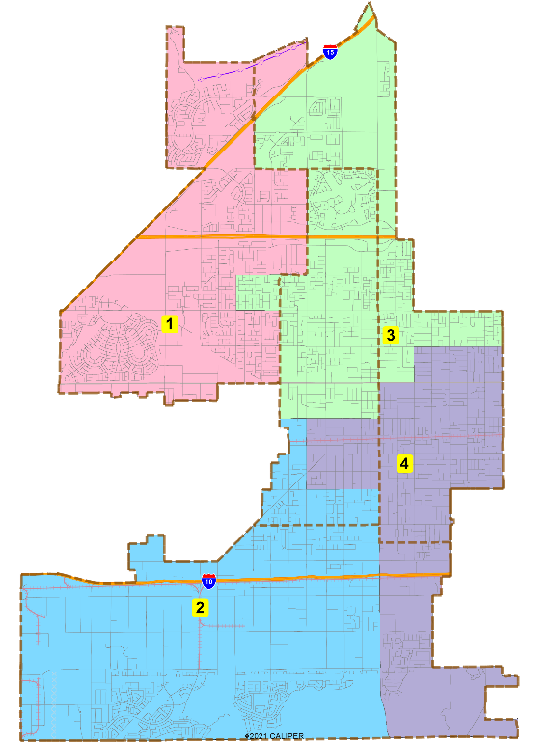
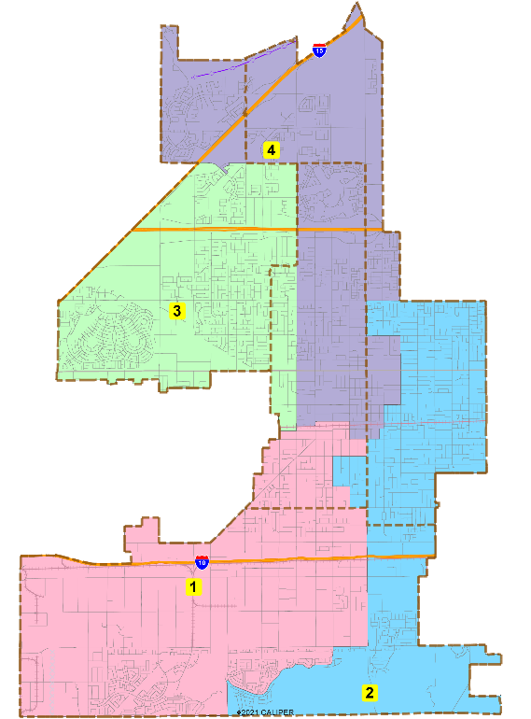
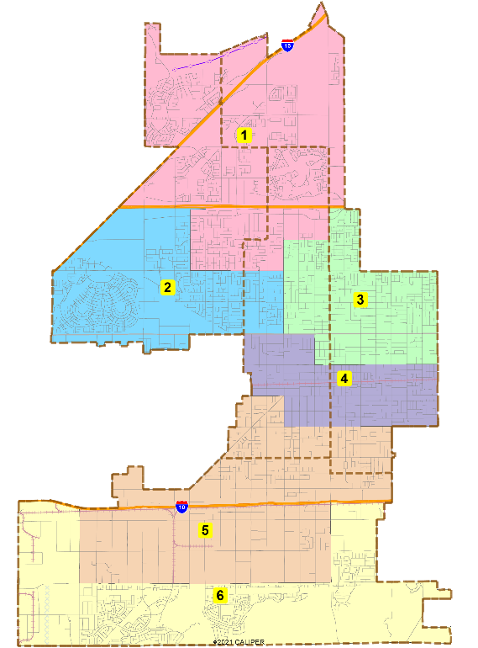
Public Map Submissions
401
402
403
604
Interactive Review Map

Slide 6
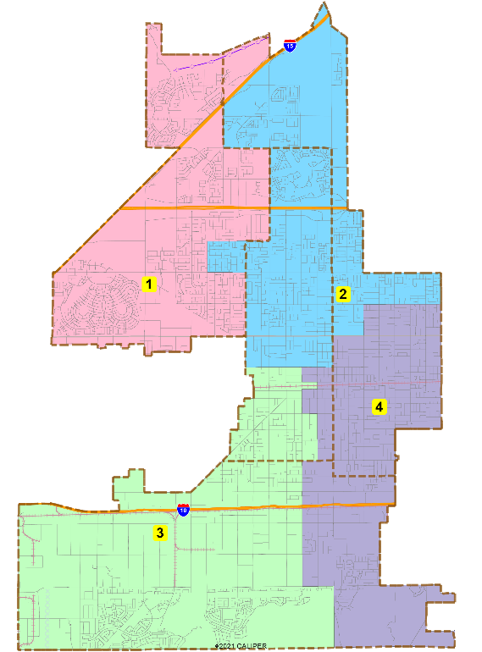
Council-Selected Focus Maps
103
402
104b

Slide 7
Demographic Summary
Population Balance
  Maps 101 – 104b and 401 – 403 are all population balanced, with plan deviations ranging from 0.11% to 5.94%. All are well below the 10% maximum deviation considered “presumptively constitutional.”
Voting Rights Act compliance
  The current map has three Latino-majority districts and a Latino-plurality District 1
  Maps 101 – 104b and 401 – 403 all at least preserve those numbers

Slide 8
Discussion
Conduct a Public Hearing
Council discussion and potential map selection

